Slide 1
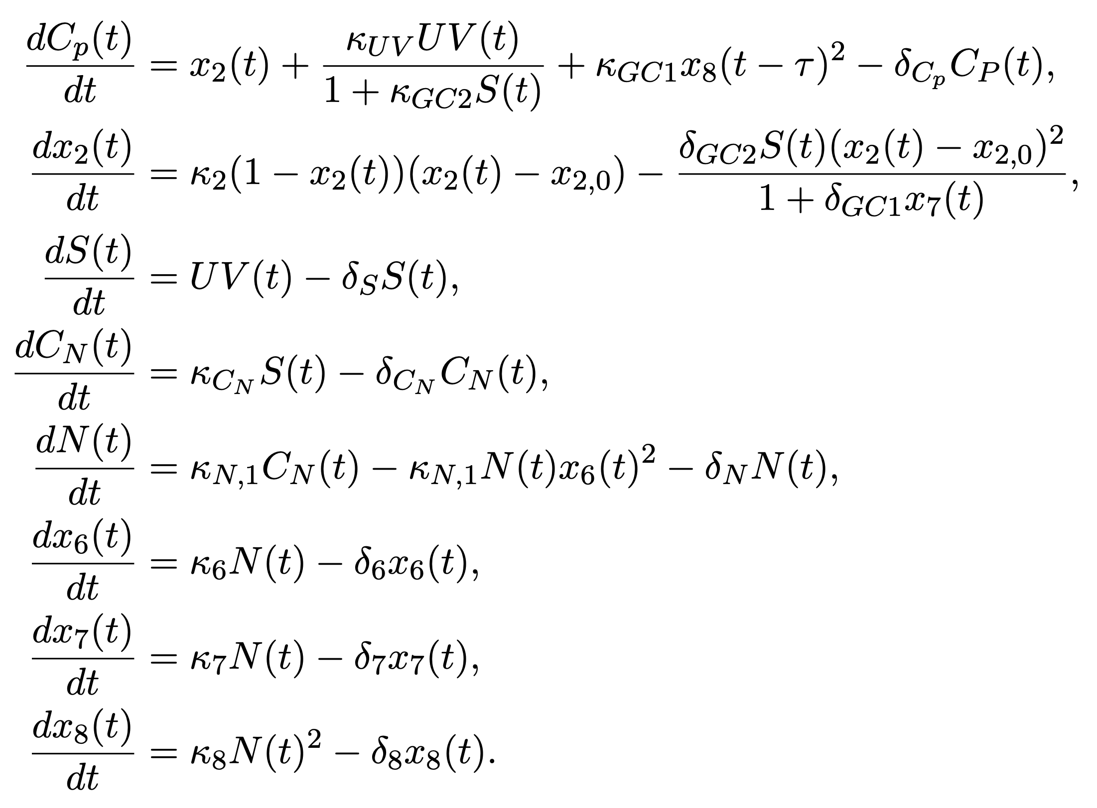
Ca in cPRC depends directly on UV and a delayed signal based on NO x₈(t) .
Dynamics of x₂(t), the base concentration/ steady state of Ca in cPRC. Quadratic because I want two fixed points (1 and x_{2,0} ) to make it easier to control the dynamics. Depends on NIT-GC2 signal S(t) and non-delayed signal based on NO x₇(t).
NIT-GC2 signal S(t).
Ca in INNOS depends on the S(t) signal.
Production of NO is proportional to Ca in INNOS. To get a limited time production of NO, equations 5 and 6 are like equations of the perfect step adaptation from: https://www.nature.com/articles/srep01251.
2nd equation of NO production.
Signaling proportional to NO that changes the base concentration/ steady state of Ca in cPRC.
Signaling proportional to NO that changes the concentration of Ca in cPRC.
Not sure if x₇ and x₈ should be in cPRC or in INNOS.
x₇(t) is the part of the model I’m the least happy with. But it works…

Slide 2
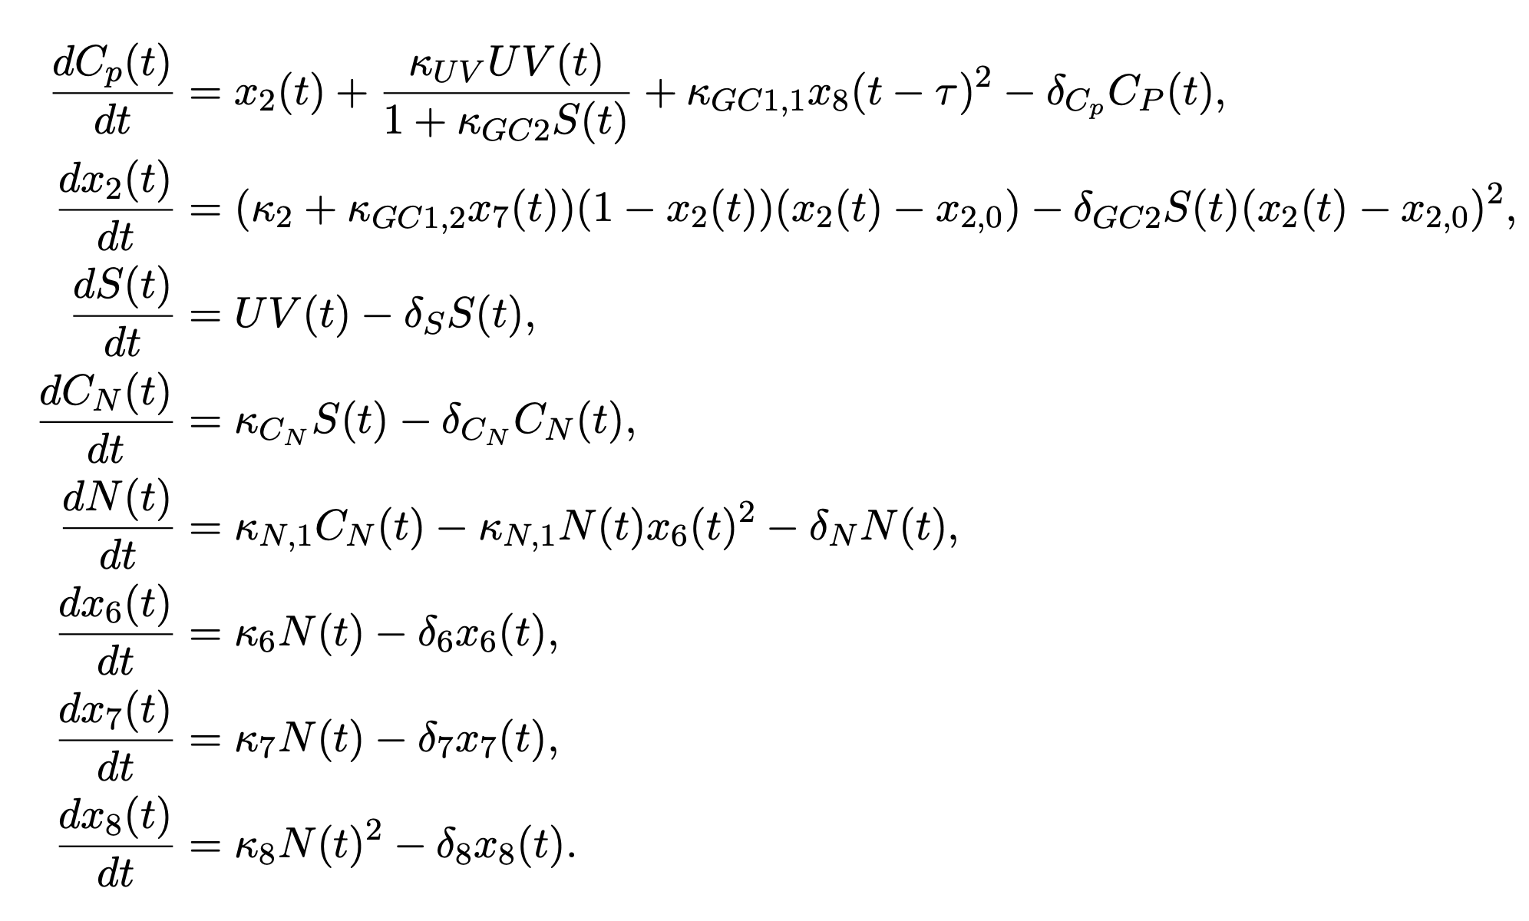
Ca in cPRC depends directly on UV and a delayed signal based on NO x₈(t) .
Dynamics of x₂(t), the base concentration/ steady state of Ca in cPRC. Quadratic because I want two fixed points (1 and x_{2,0} ) to make it easier to control the dynamics. Depends on NIT-GC2 signal S(t) and non-delayed signal based on NO x₇(t).
NIT-GC2 signal S(t).
Ca in INNOS depends on the S(t) signal.
Production of NO is proportional to Ca in INNOS. To get a limited time production of NO, equations 5 and 6 are like equations of the perfect step adaptation from: https://www.nature.com/articles/srep01251.
2nd equation of NO production.
Signaling proportional to NO that changes the base concentration/ steady state of Ca in cPRC.
Signaling proportional to NO that changes the concentration of Ca in cPRC.
Not sure if x₇ and x₈ should be in cPRC or in INNOS
x₇(t) is the part of the model I’m the least happy with. But it works…

Slide 3
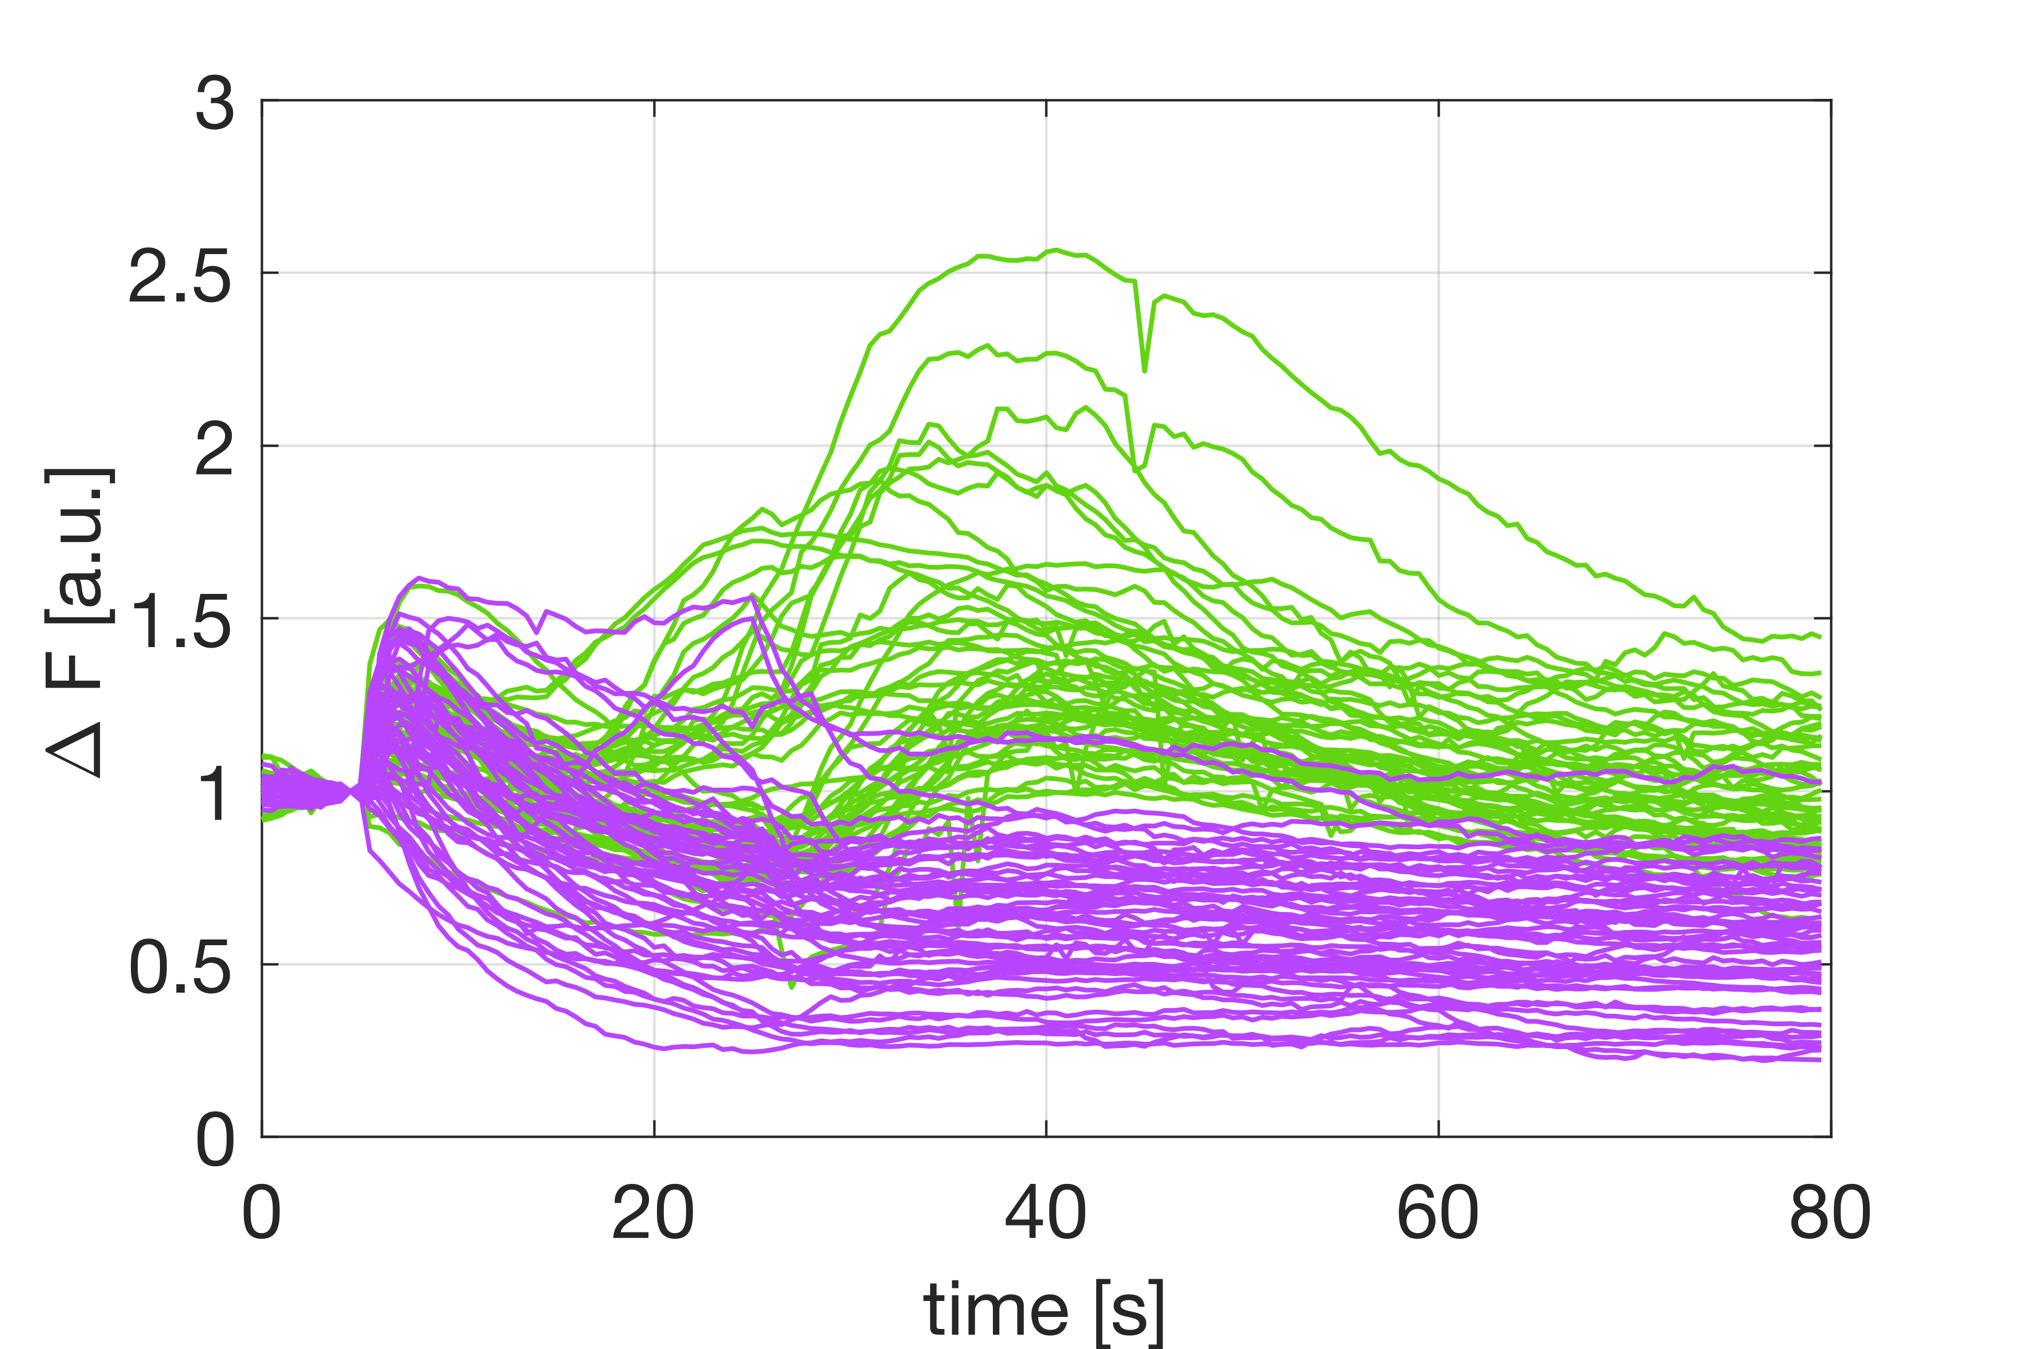
Need for x₇ comes from the observation that there is almost no overlap between NO ko & WT.

Slide 4
Fitting - steps and results

Slide 5
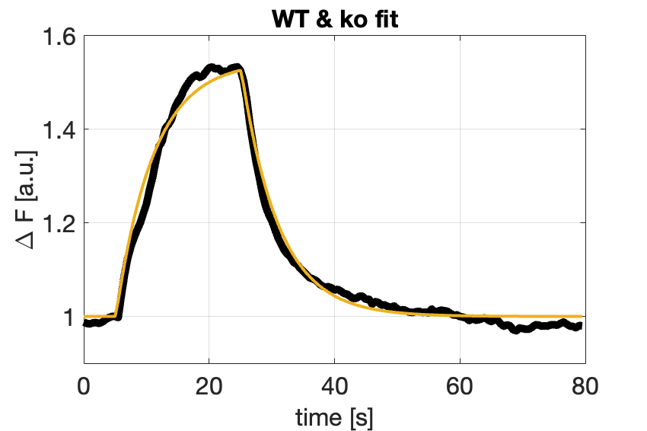
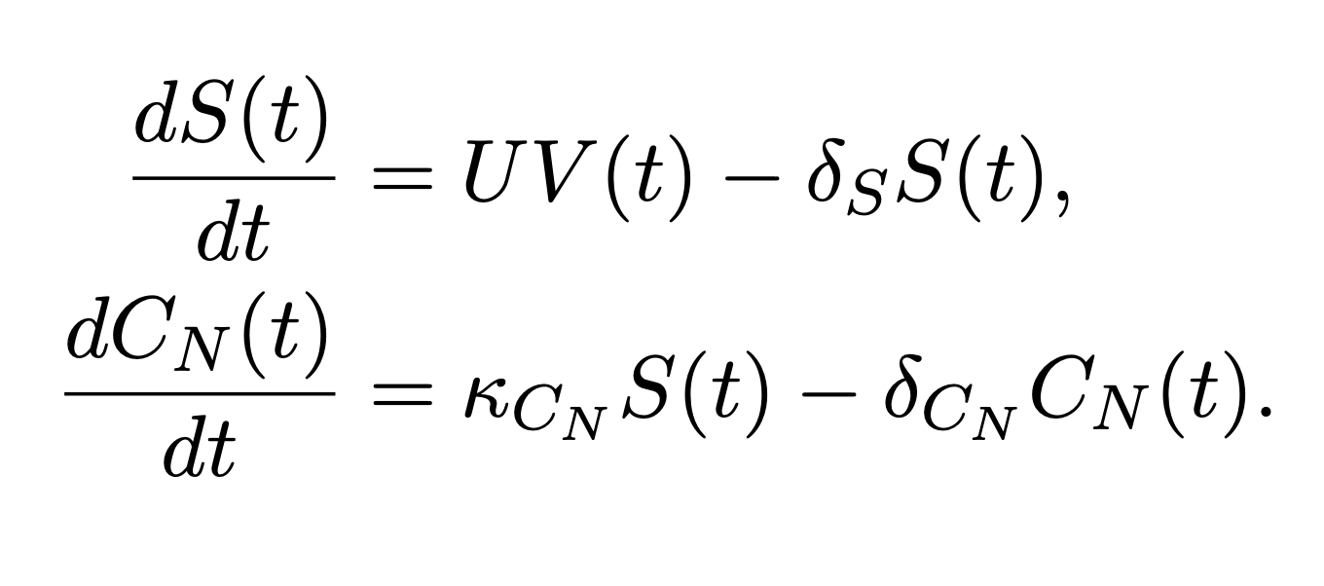
1.) INNOS (WT & ko together)
Assuming that the signal is a result of NIT-GC2.
Started with this part of the system because it is a simple dynamics.
And it looks the same for WT and ko.
I keep the values of the parameters fixed in for the other models.

Slide 6
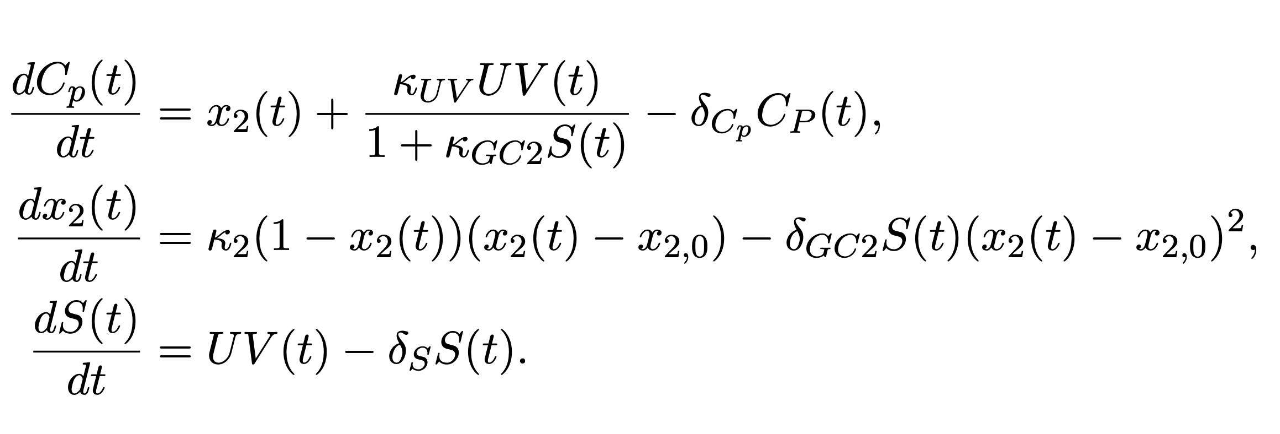
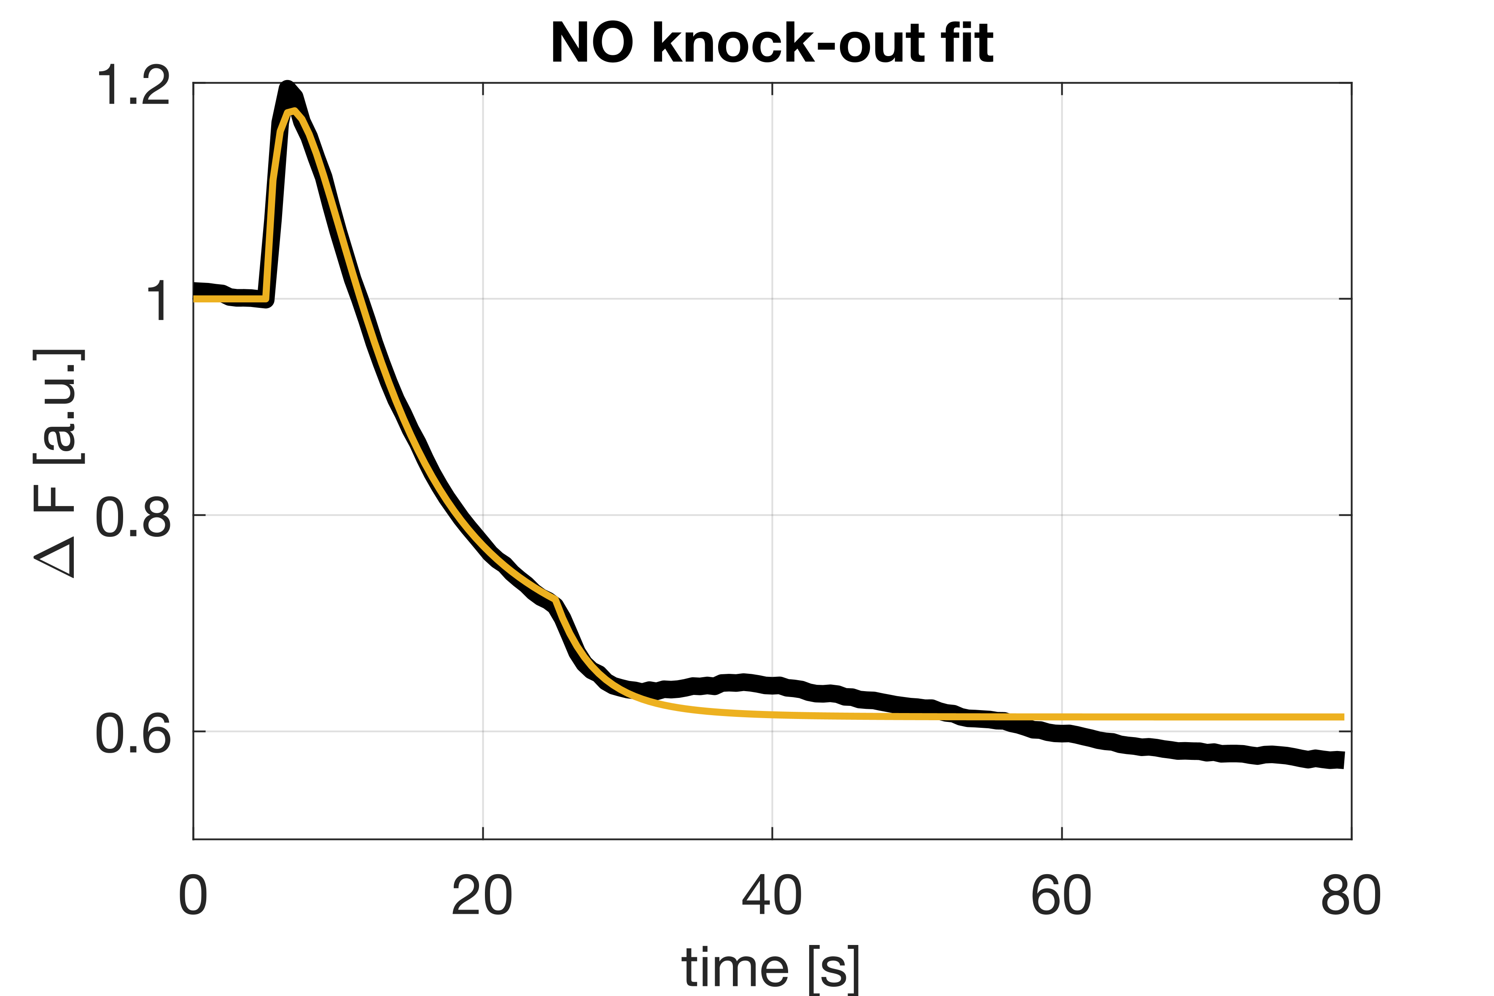
2.) NO knock-out
quadratic because I want
two fixed points (1 and x_{2,0} ) to
control the dynamics
value fixed in step 1
I assume that NIT-GC2 inhibits the action of UV and lowers the base level of Ca in cPRC cells.
Activity of NIT-GC2 is ‘proportional’ to the level of S(t).
I keep the values of the parameters fixed in for the other models.

Slide 7
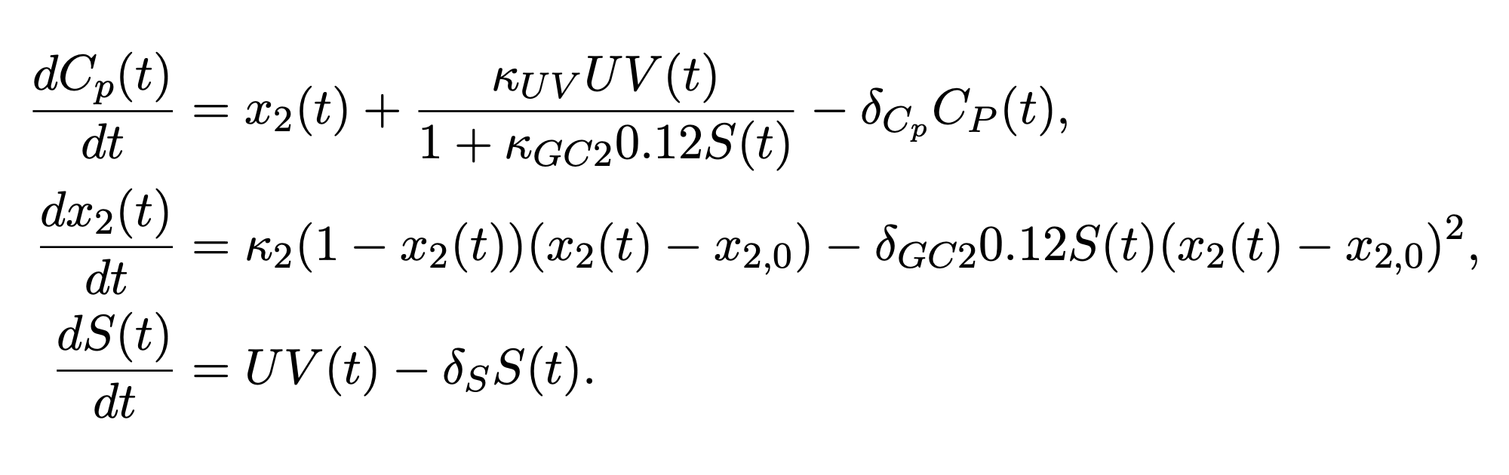
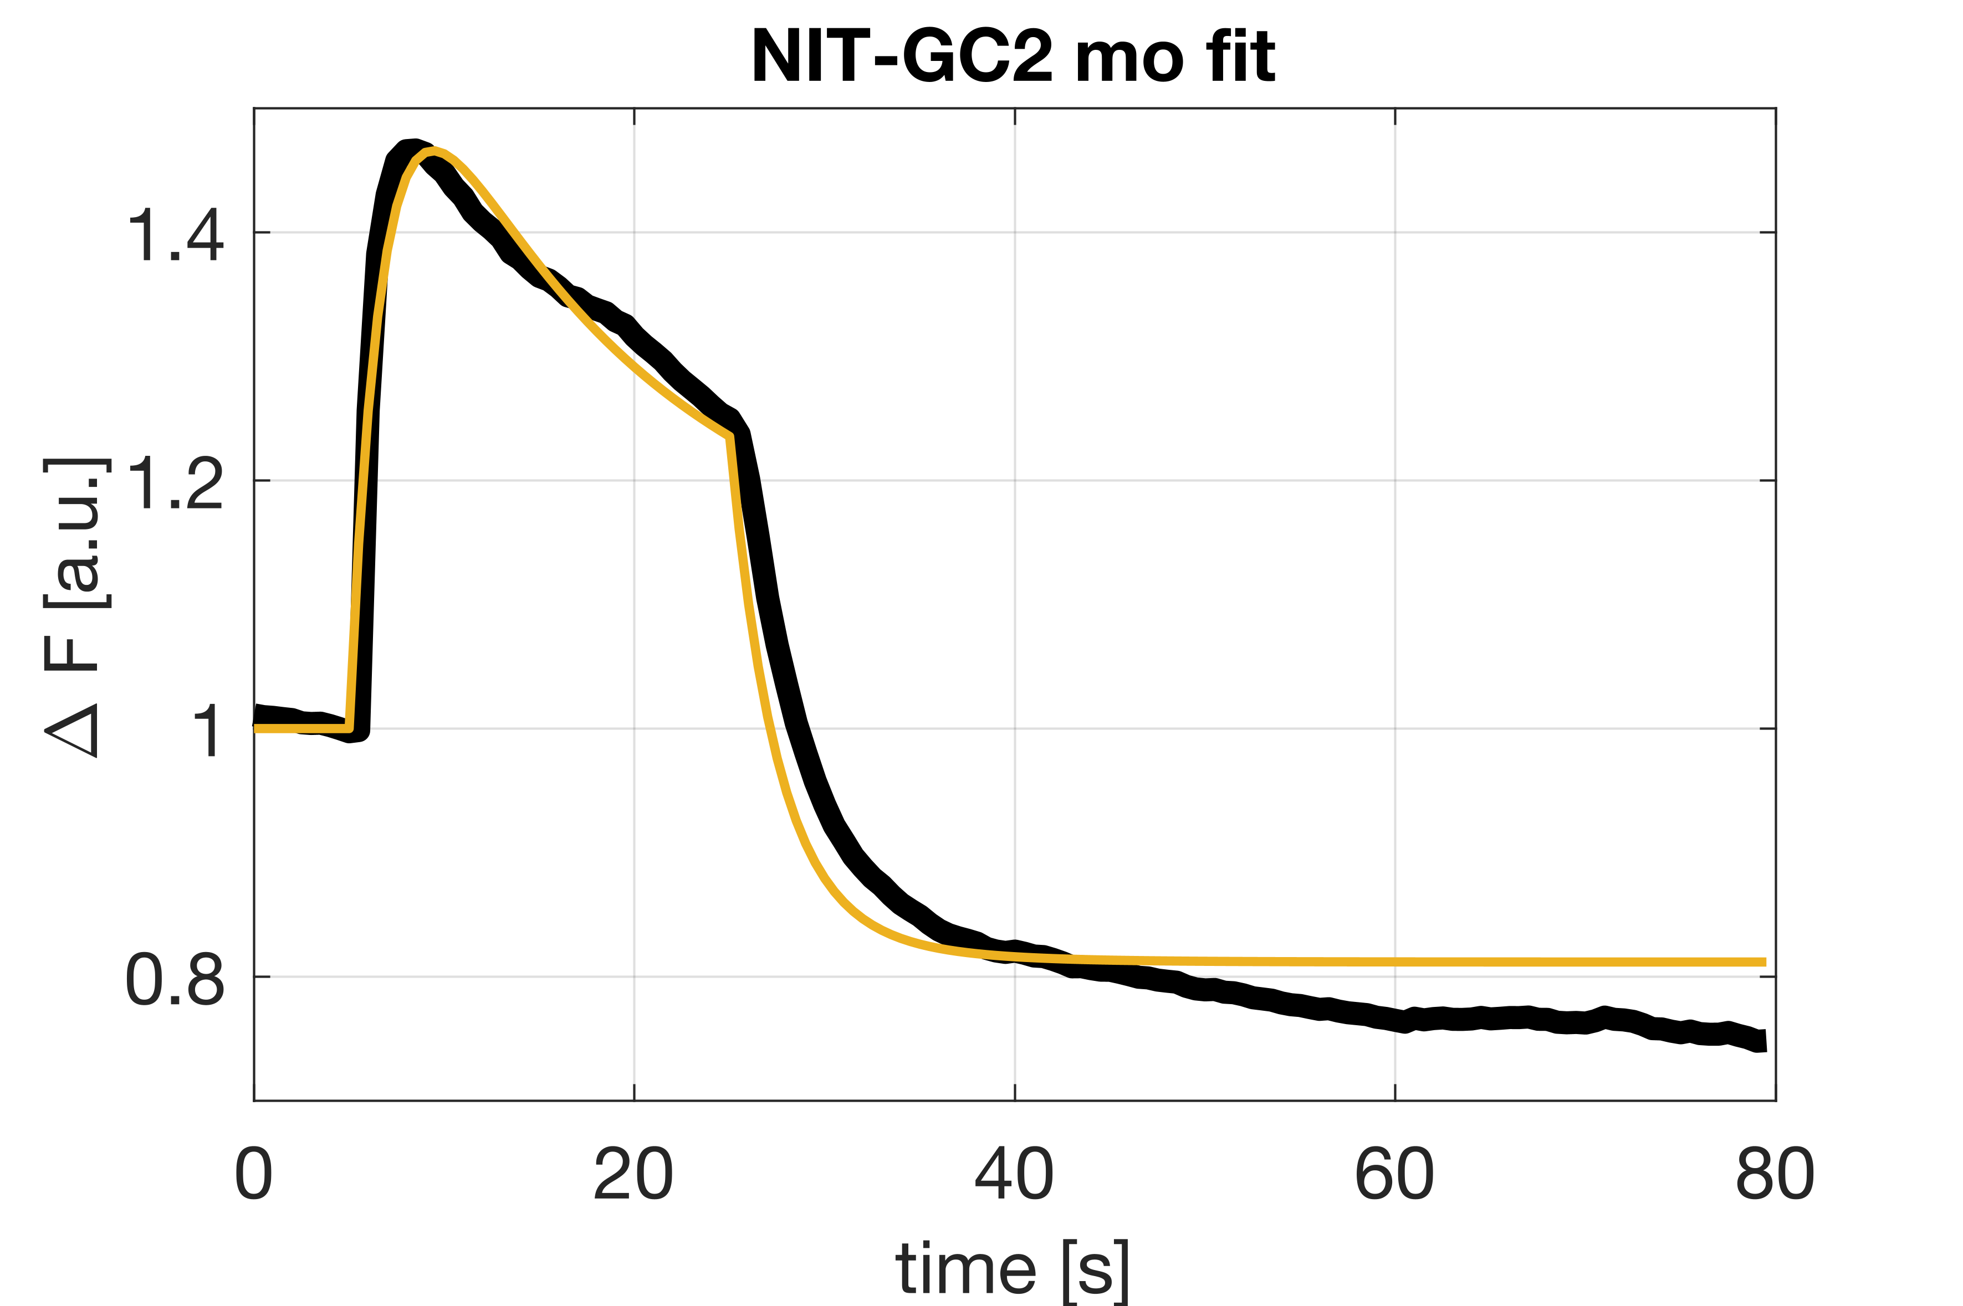
3.) NIT-GC2 morpholino
After fitting the NO ko model I by accident observed that if I multiply the S(t) by 0.12, I’m getting a very good fit to the NIT-GC2 morpholino data.
All the parameter values are the same as in the NO ko model.

Slide 8
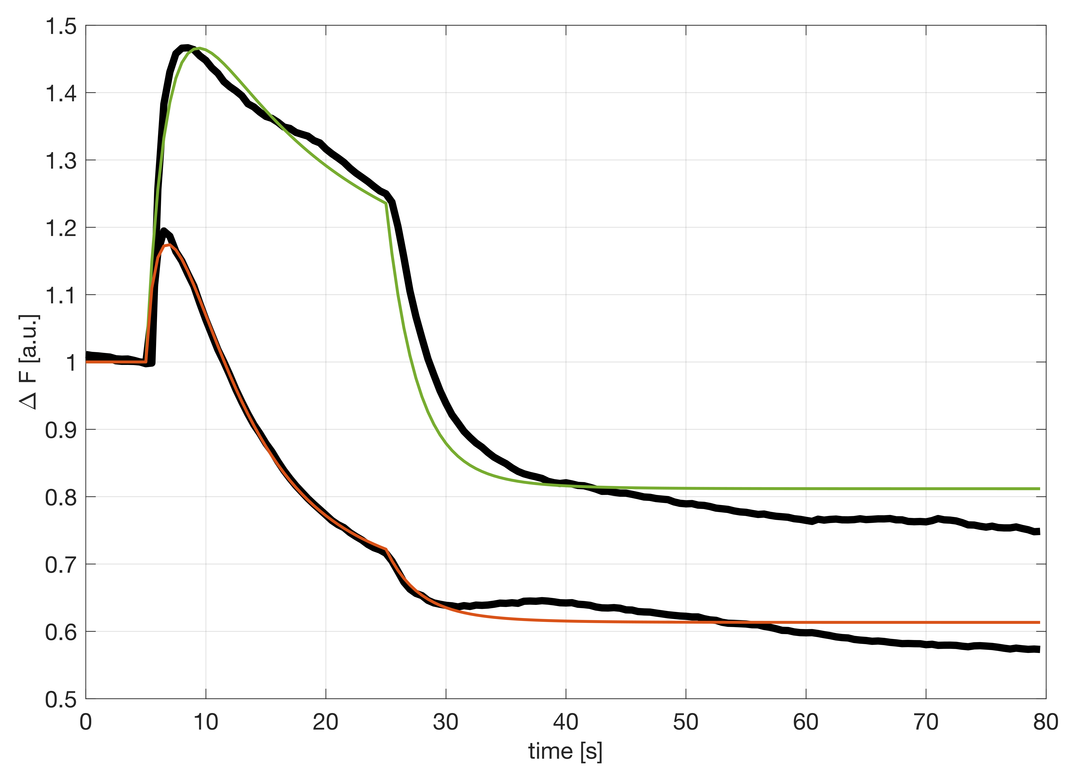
Same model gives good fits for NO ko and NIT-GC2 mo.
The difference is the amount of S(t) that is being ‘produced’.
It appears that on average morpholino reduces NIT-GC2 activity to about 12%.

Slide 9
5 values fixed in step 2
3 values fixed in step 1
12 values (including the delay) to fit in the last step

Slide 10
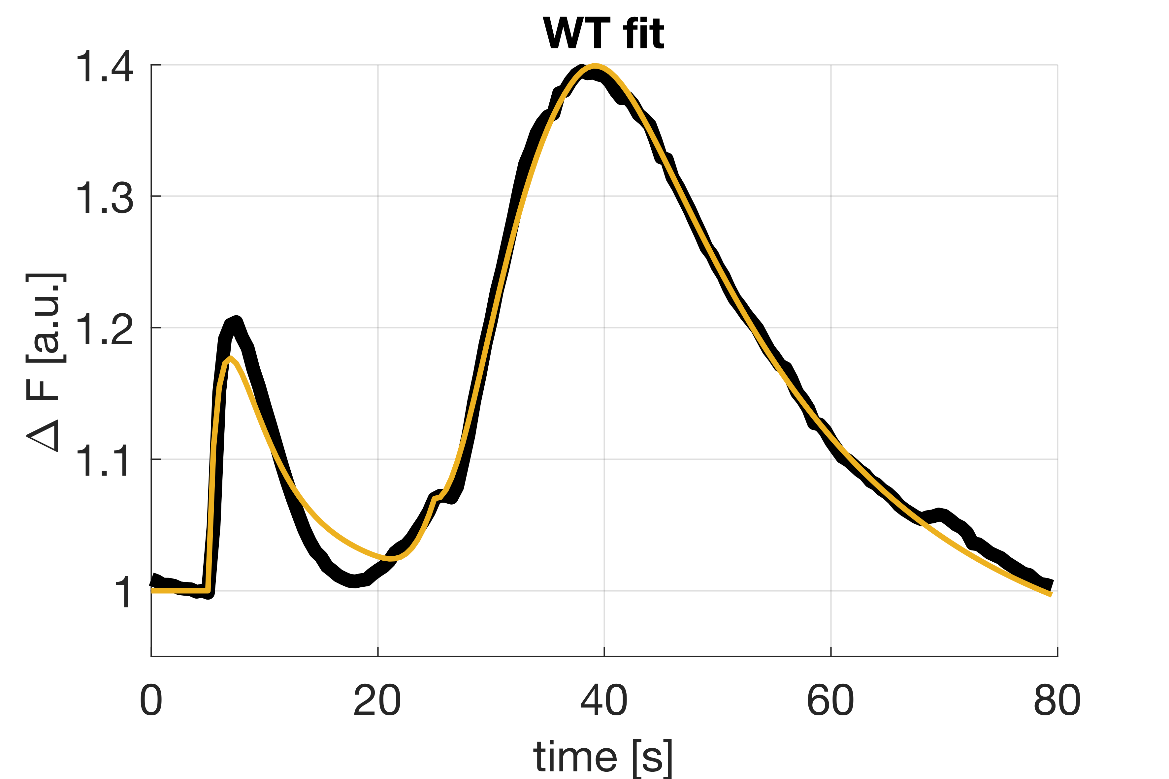

Slide 11
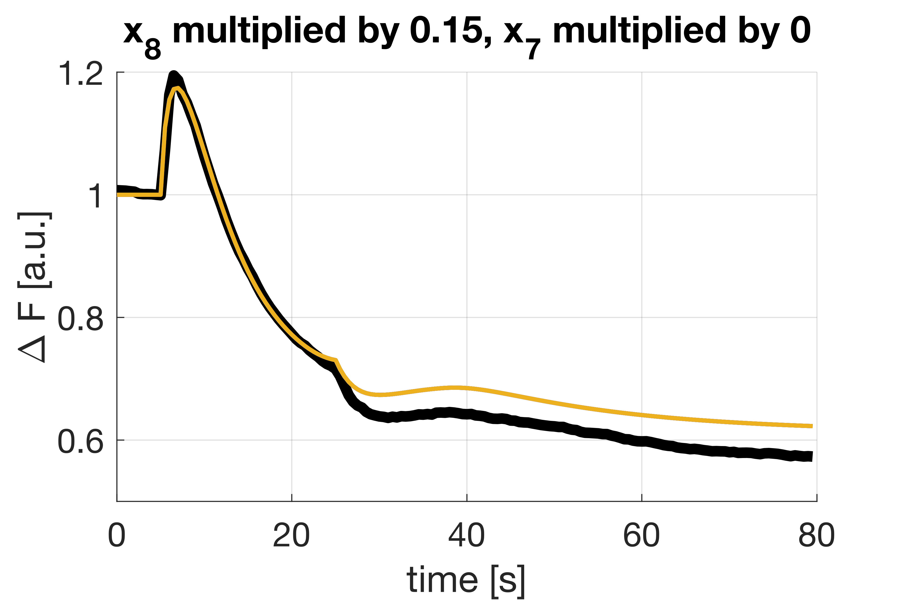
NO knock-out simulated using full model parameters fitted to WT data. I kept parameters the same. To get the yellow curve I’ve multiplied x₇ by 0 and x₈ by 0.15. Plot suggests that the knock-out is not perfect.

Slide 12
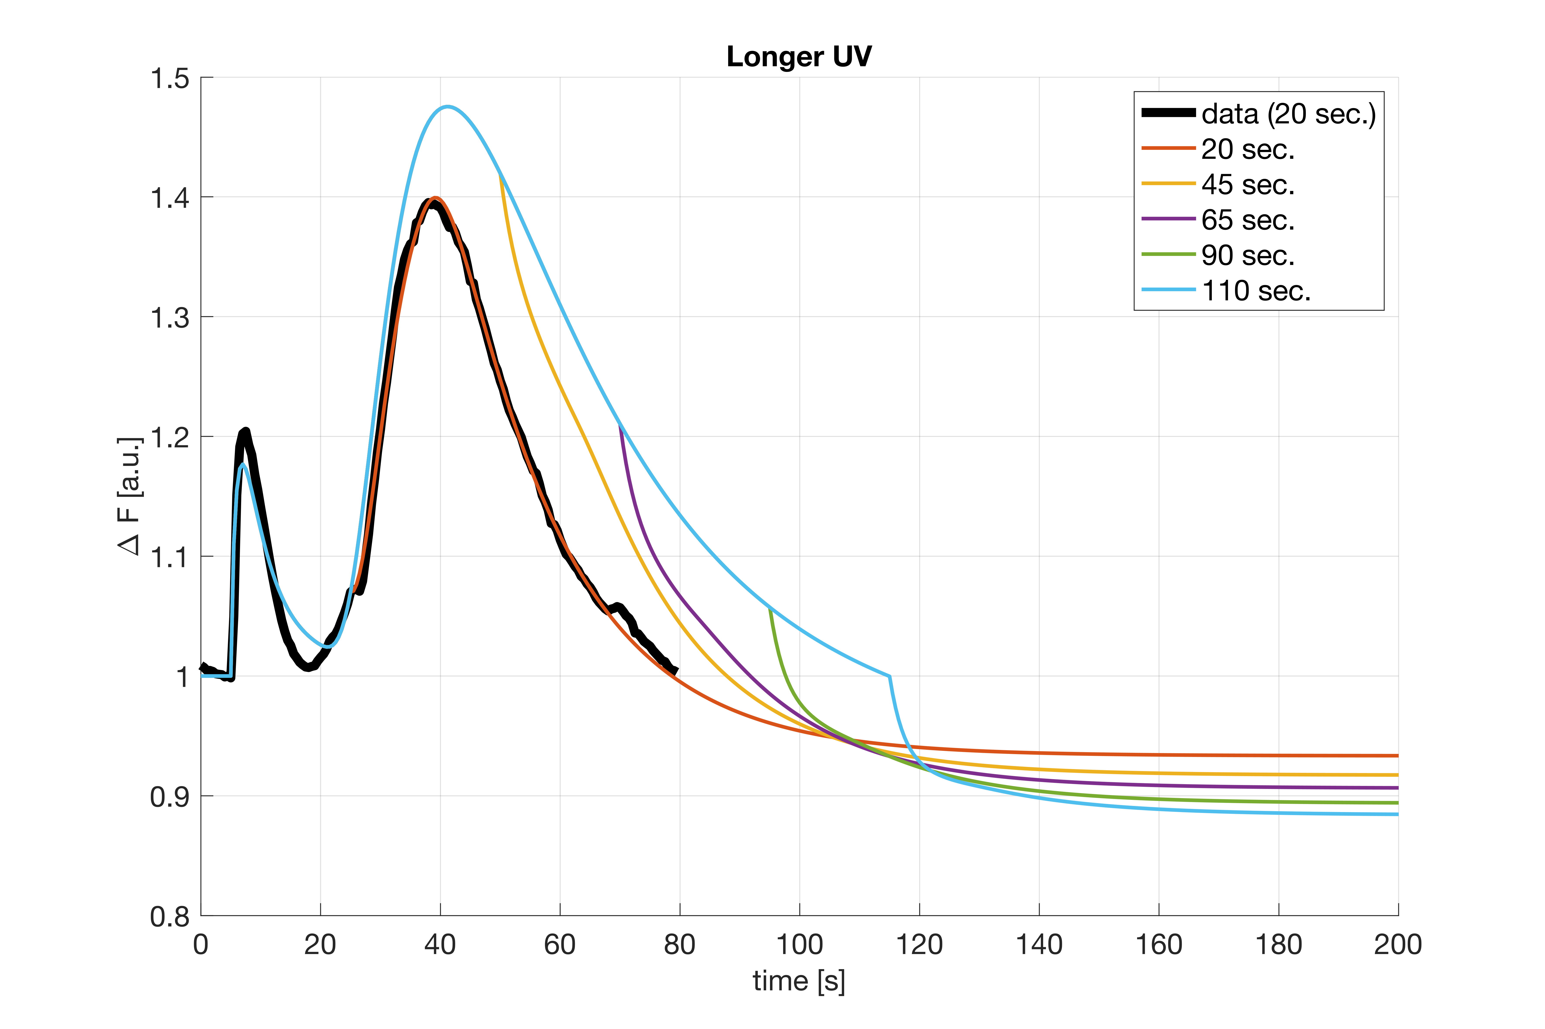

Slide 13
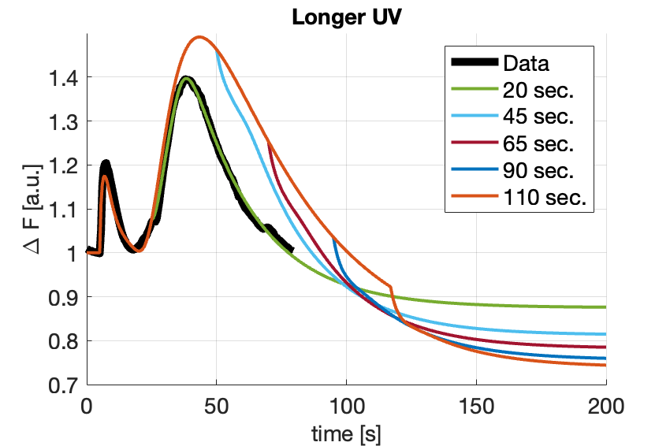
Additive
model

Slide 14
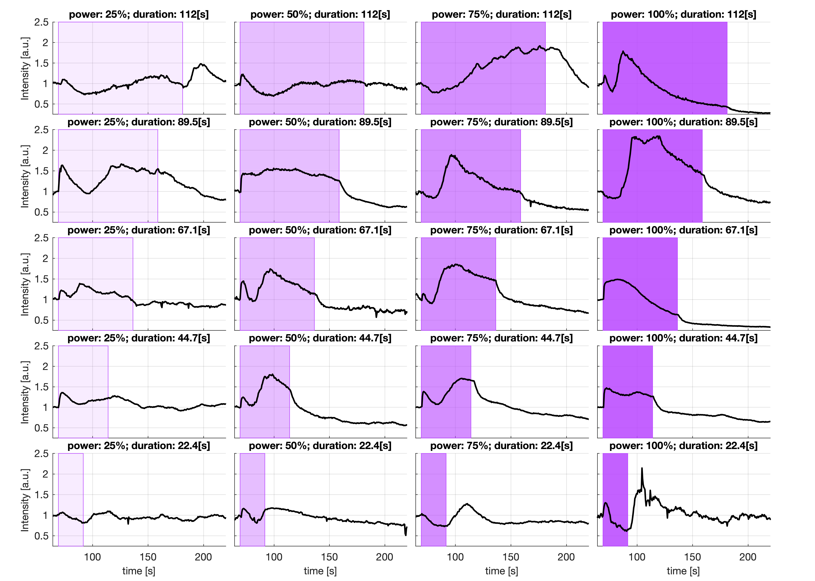
Amplitude-duration data

Slide 15
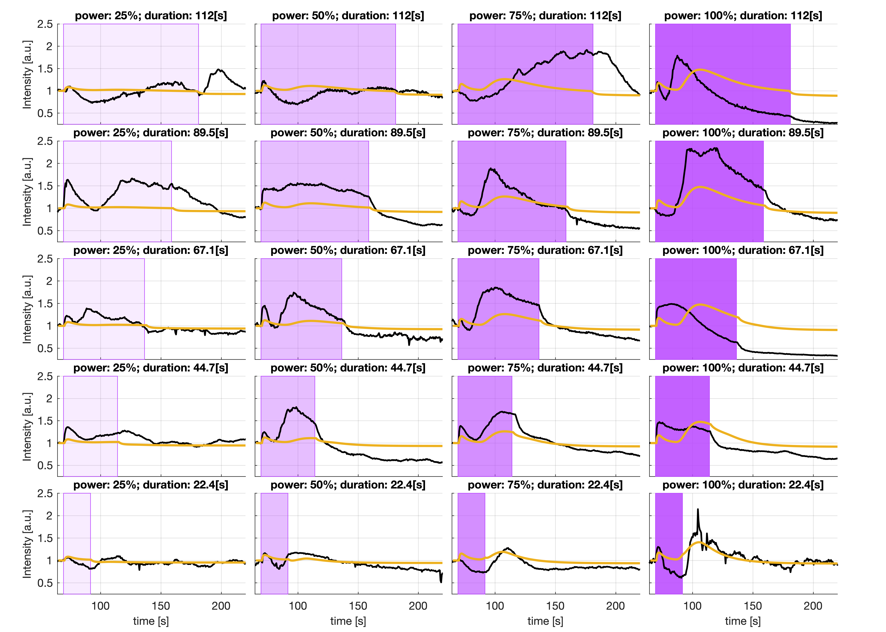
Amplitude-duration data with fits based on the average 20 sec. data (yellow).

Slide 16

Amplitude-duration data with fits based on the average 20 sec. data, additive model (green).

